Slide 1
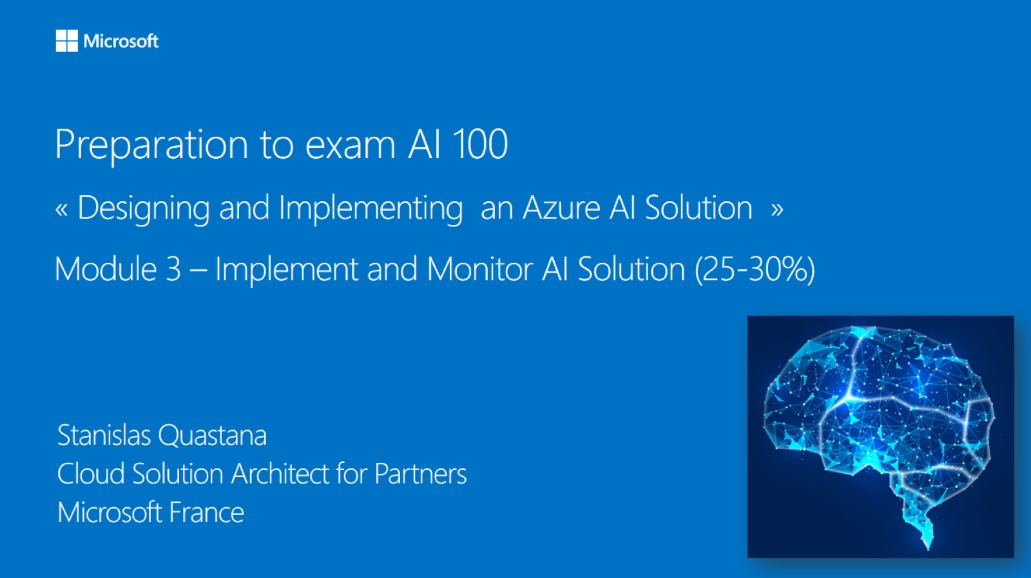

Meet Bhagdev
Program Manager
Microsoft

Slide 2
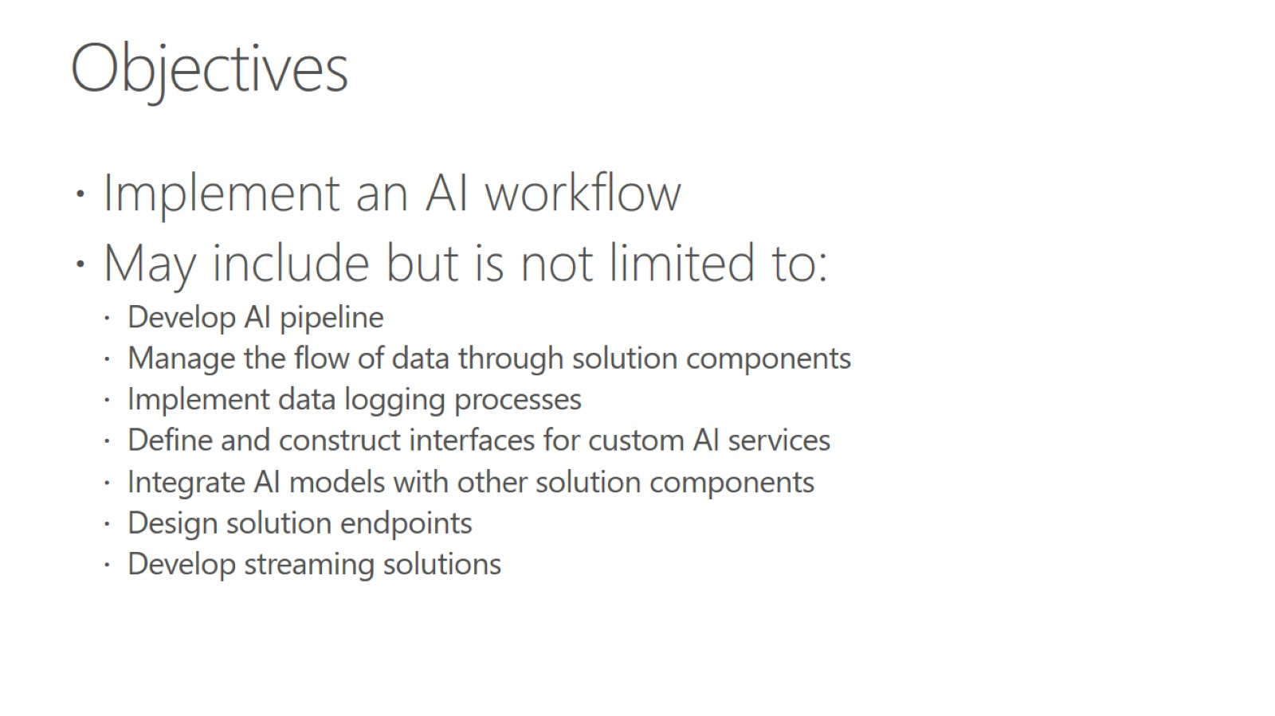
Objectives

Slide 3
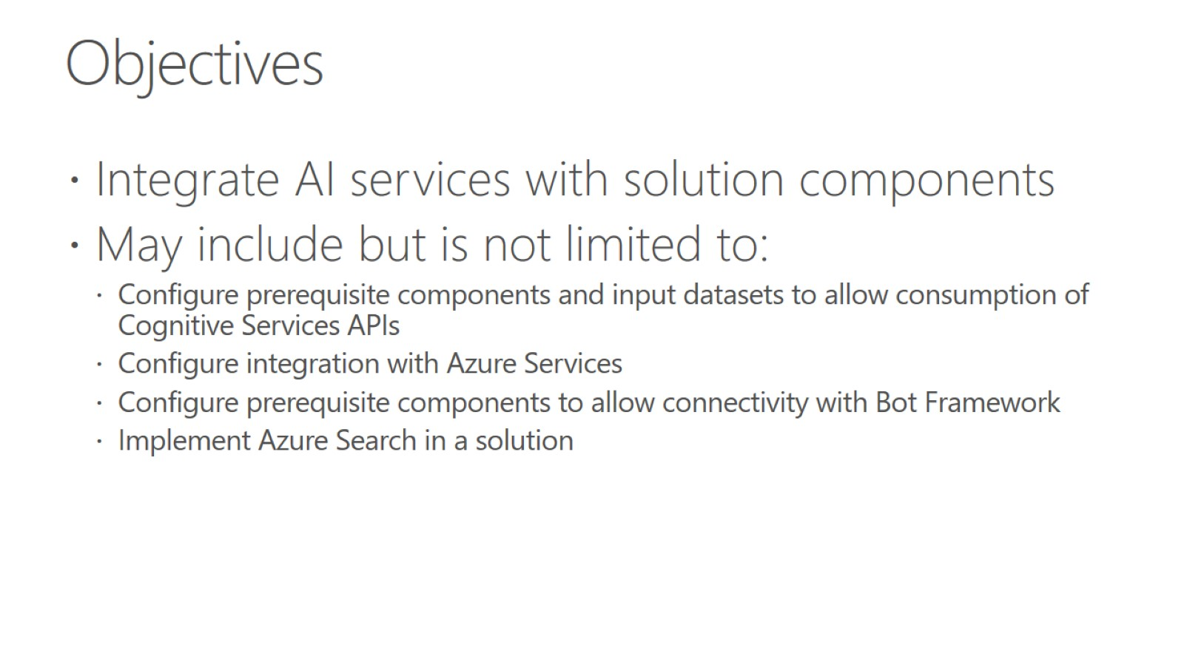
Objectives

Slide 4
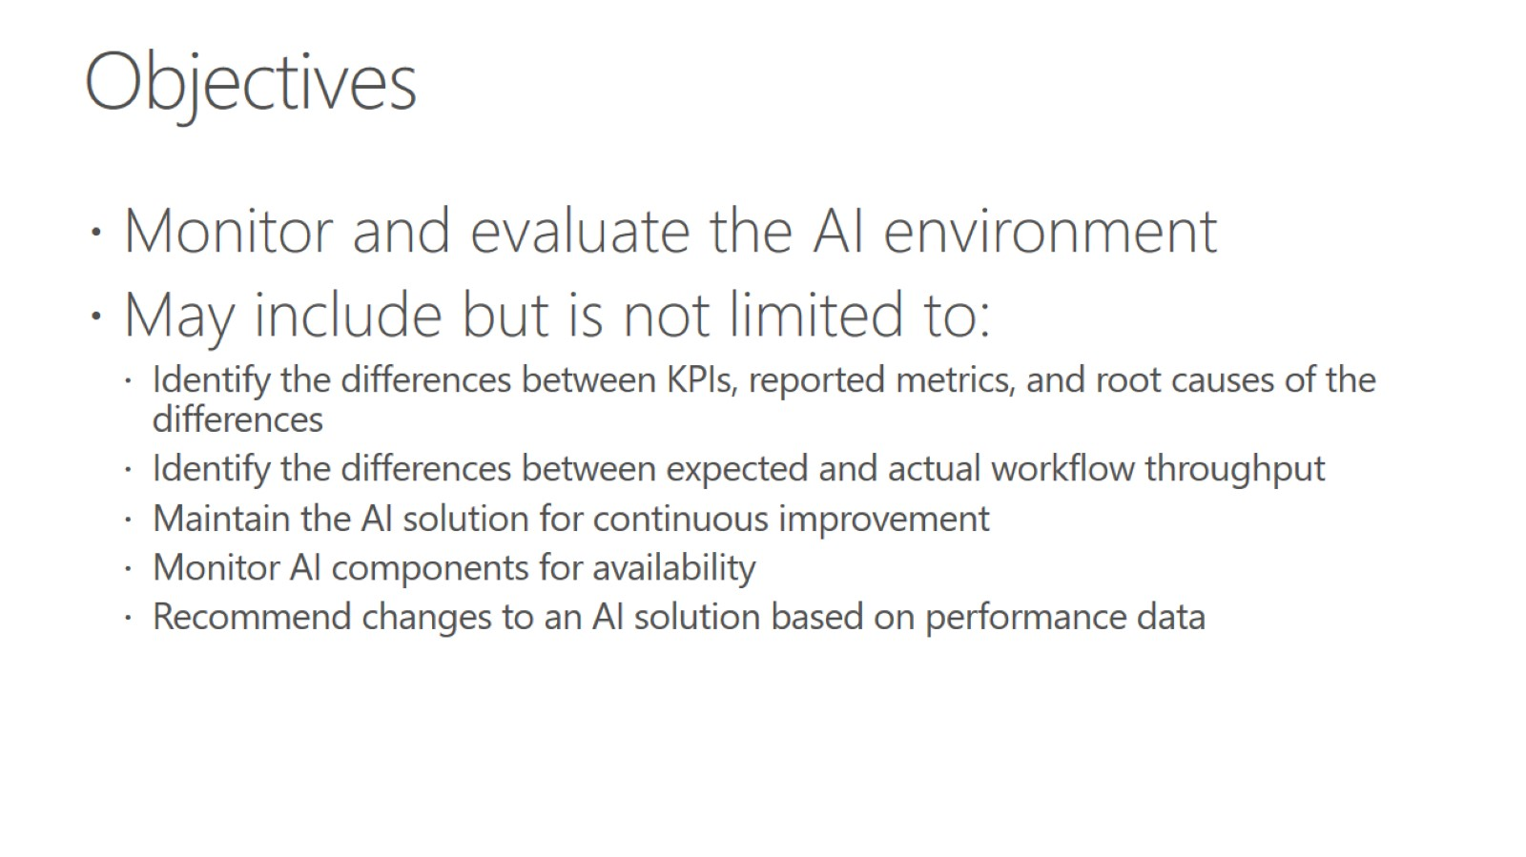
Objectives

Slide 5
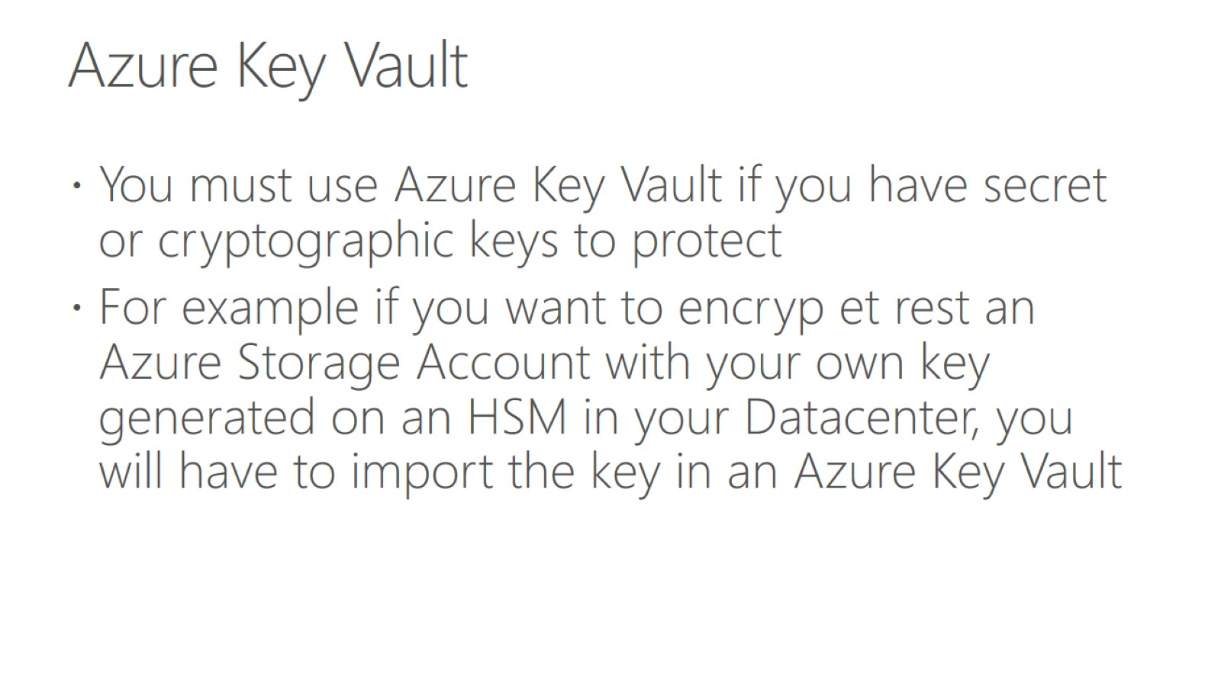
Azure Key Vault

Slide 6
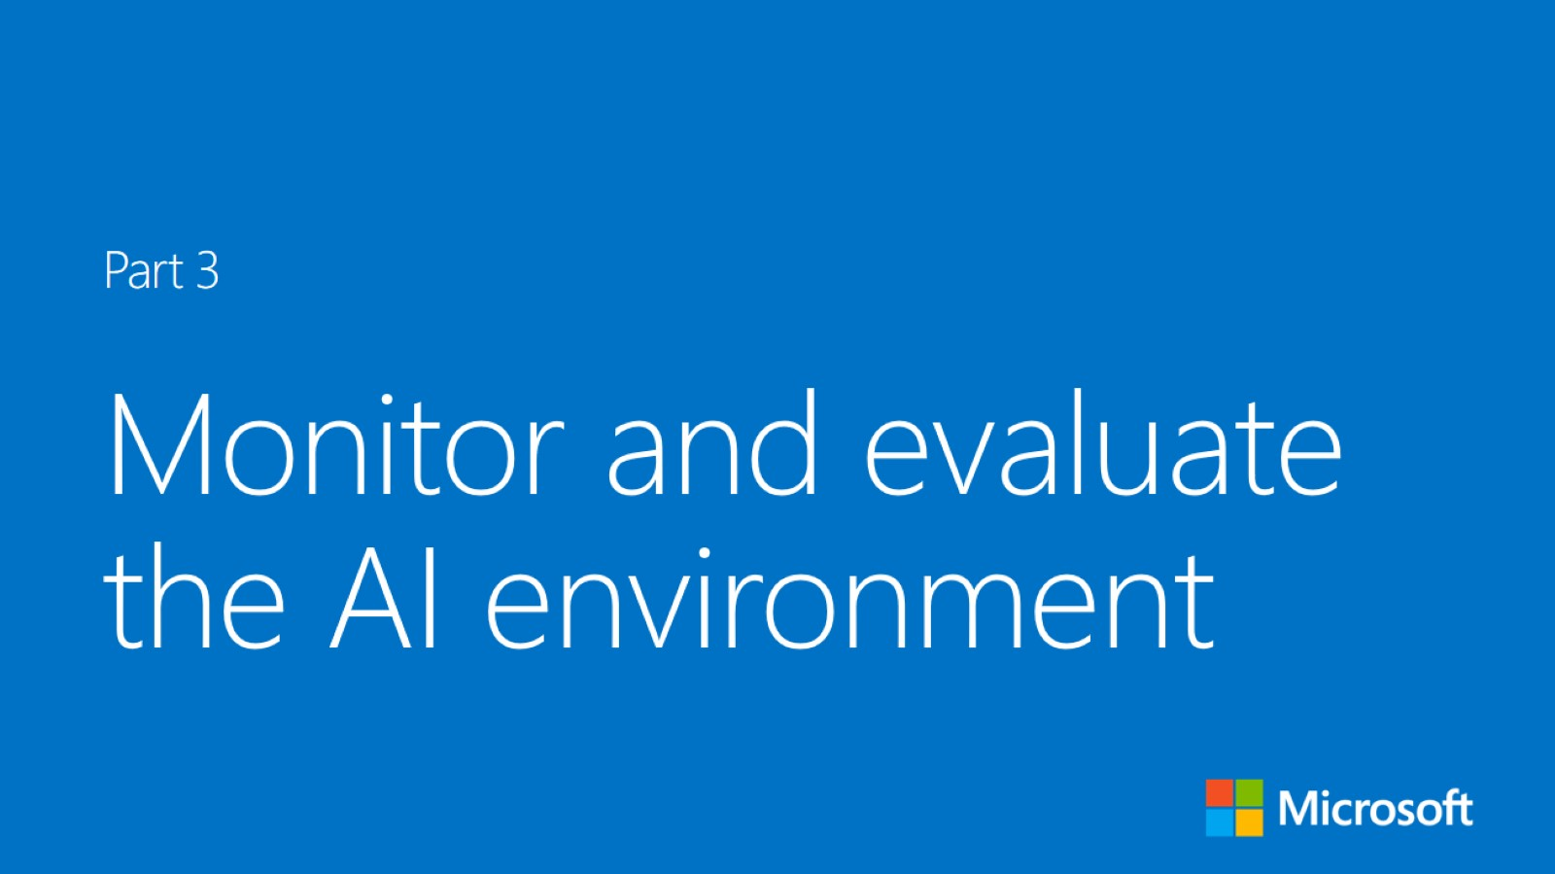


Slide 7
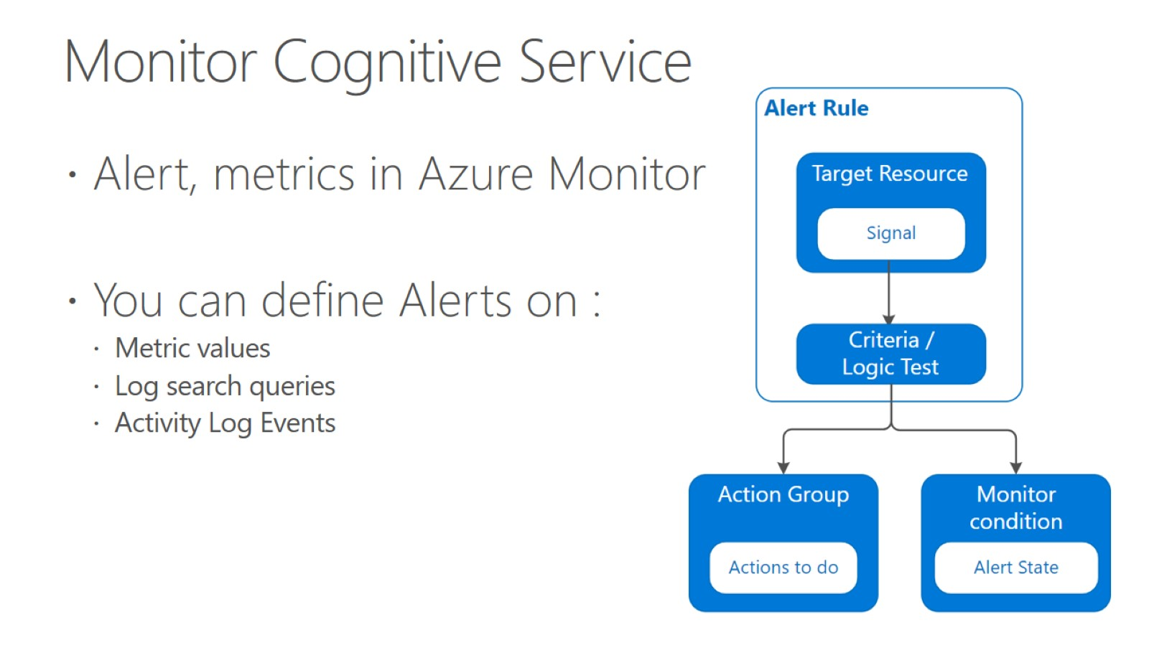
Monitor Cognitive Service

Slide 8
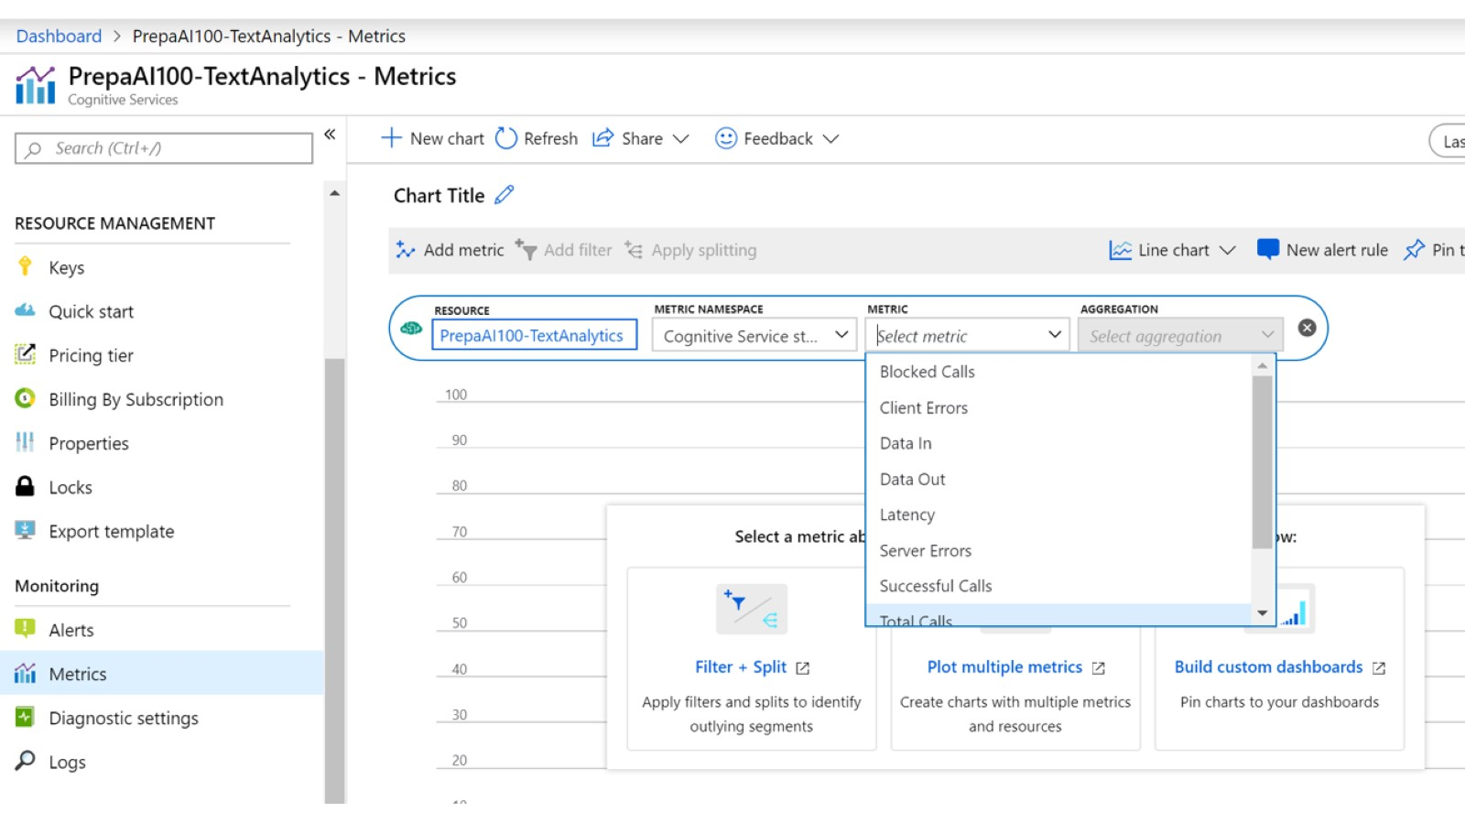

Slide 9
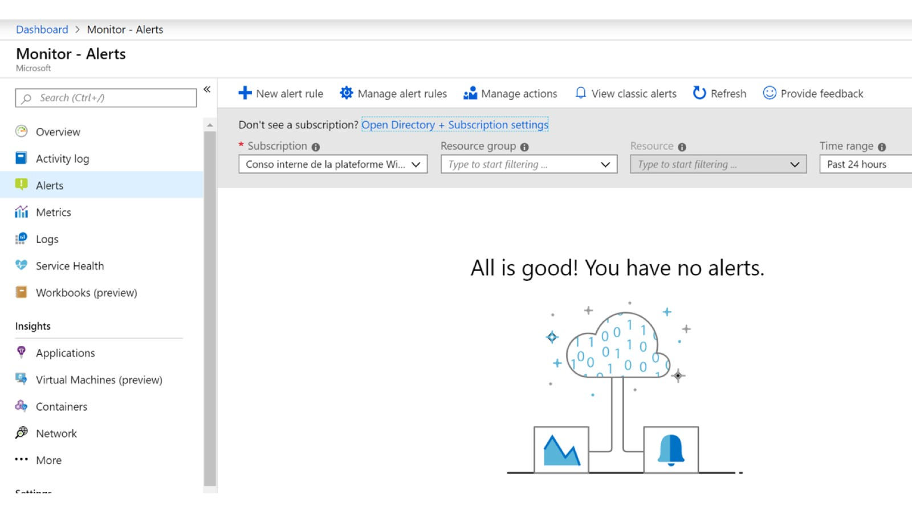

Slide 10
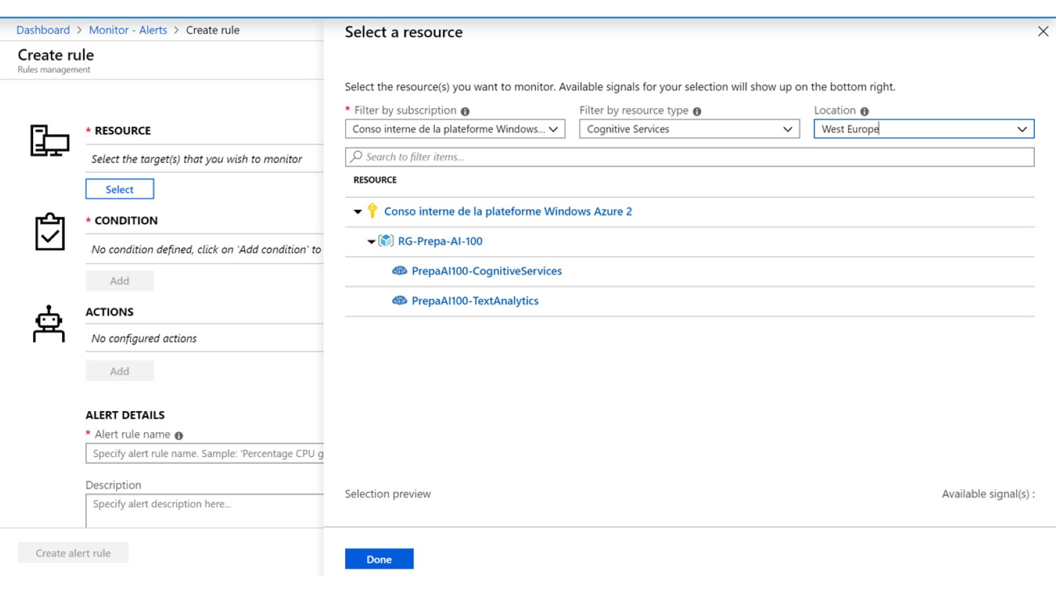

Slide 11
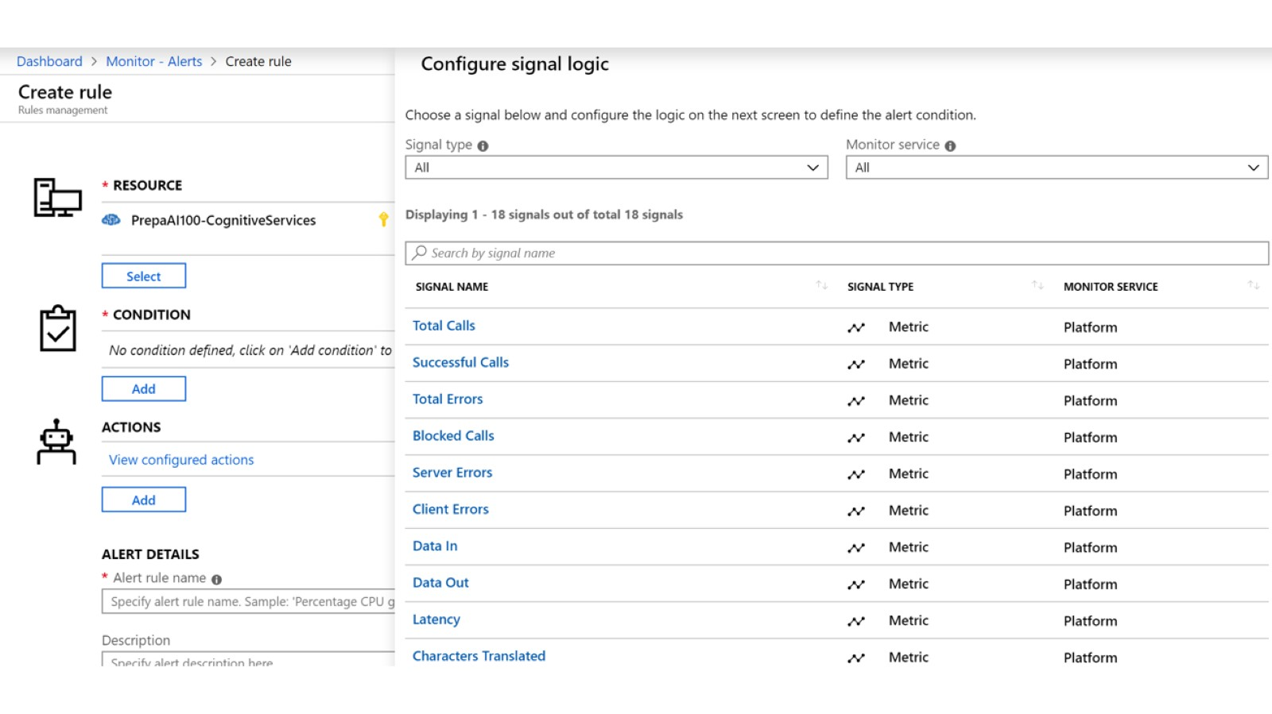

Slide 12
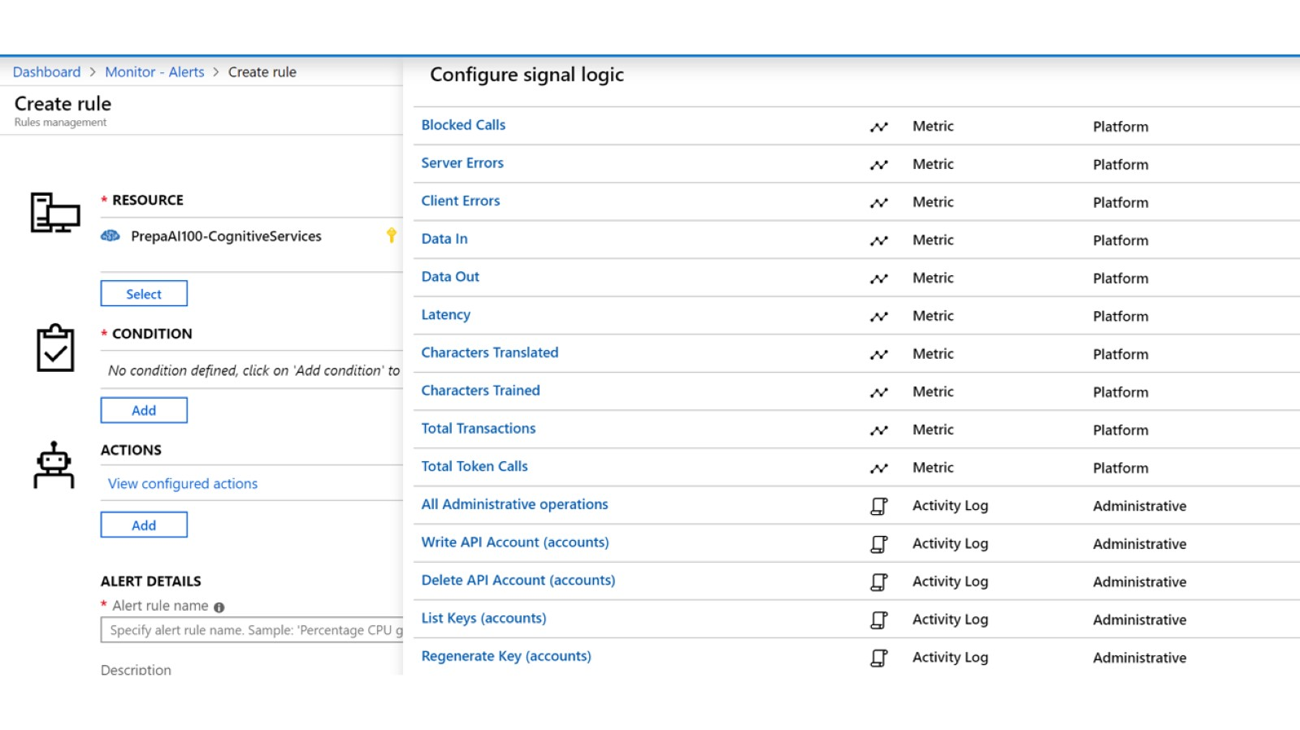

Slide 13
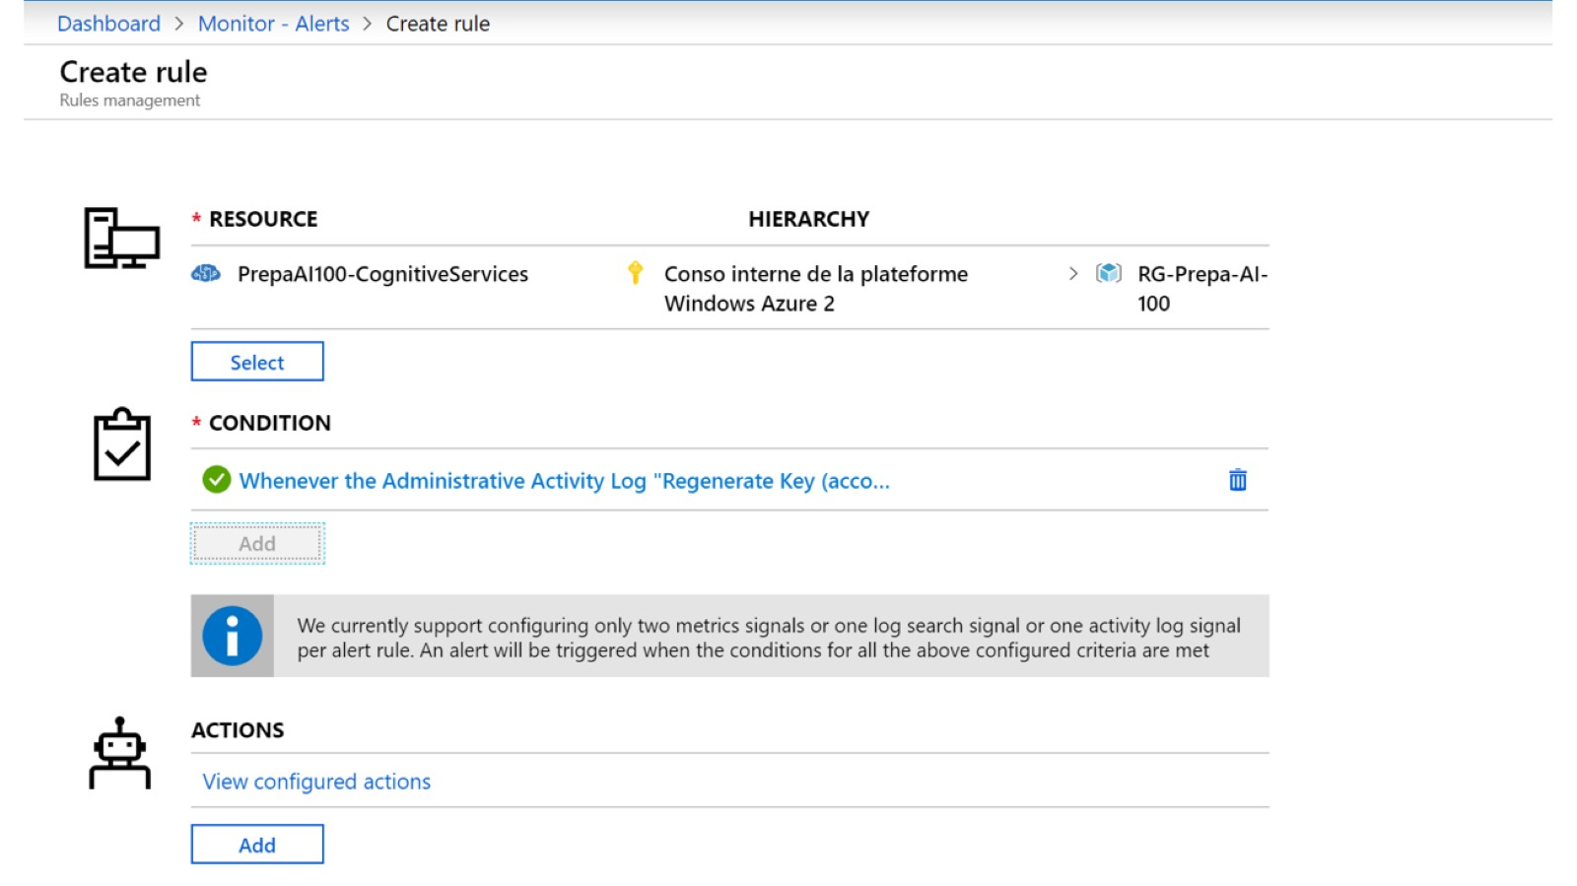

Slide 14
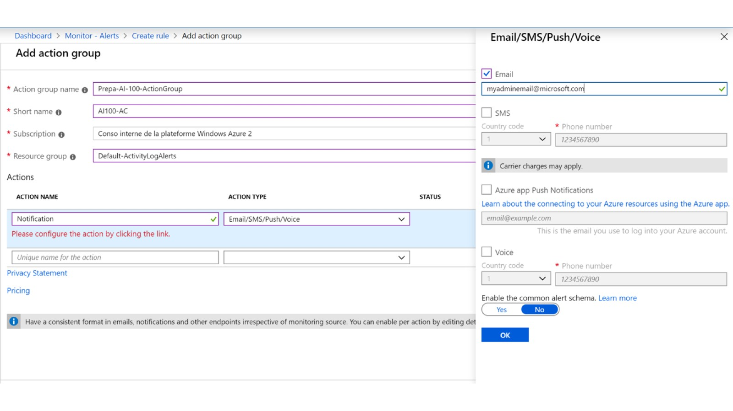

Slide 15
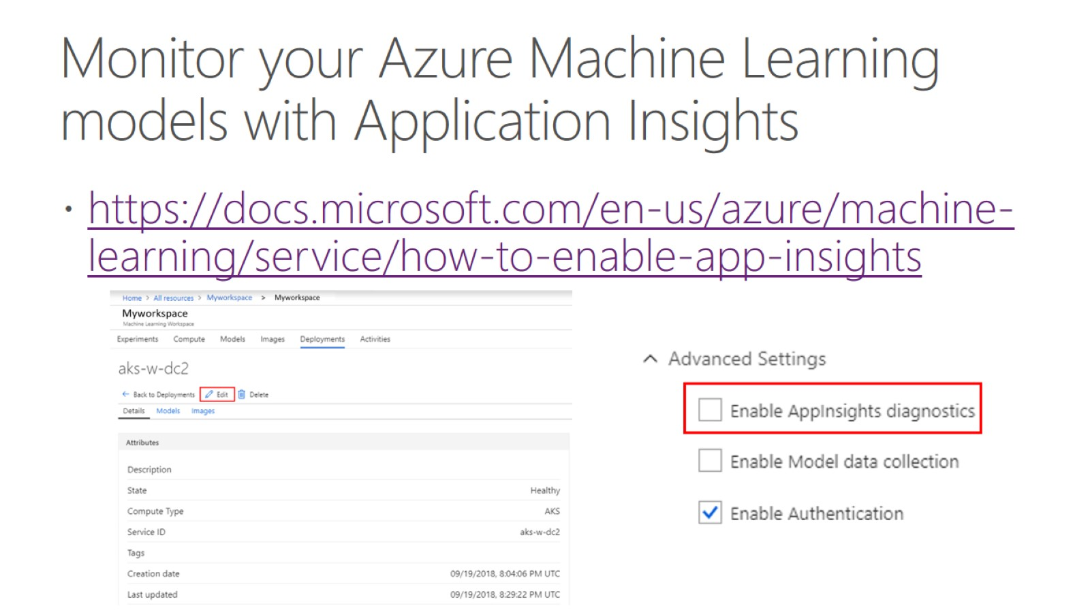
Monitor your Azure Machine Learning models with Application Insights

Slide 16
Azure Diagnostic Logs
Diagnostic logs provide rich frequent data about the operation of an Azure resource. Azure monitor makes two types of logs available –
Tenant logs – the logs that come from tenant level series that exist out side an Azure subscription such as AAD logs
Resource logs – the logs that come from each resource

Slide 17
Azure Logic Apps
Logic apps simplifies how you build automated scalable workflows that integrate with data across cloud services and on-premises systems
Think – logic app for sending notifications

Slide 18
Azure Storage Analytics
Performs logging and provides metrics data for a storage account
You can use this data to trace requests, analyze usage trends and diagnose issues with your storage accoint

Slide 19
Azure Anomaly detector
Allows you to monitor and detect abnormalities in your time series data
The API adapts by automatically identifying and applying the best fitting models to your data

Slide 20
Test
https://github.com/meet-bhagdev/ai-100/blob/master/Questions.docx

